Slide 1
IBM University Engagement Project Submission
“Exploring the Power of Agentic AI with IBM Granite and LangFlow”

Slide 2
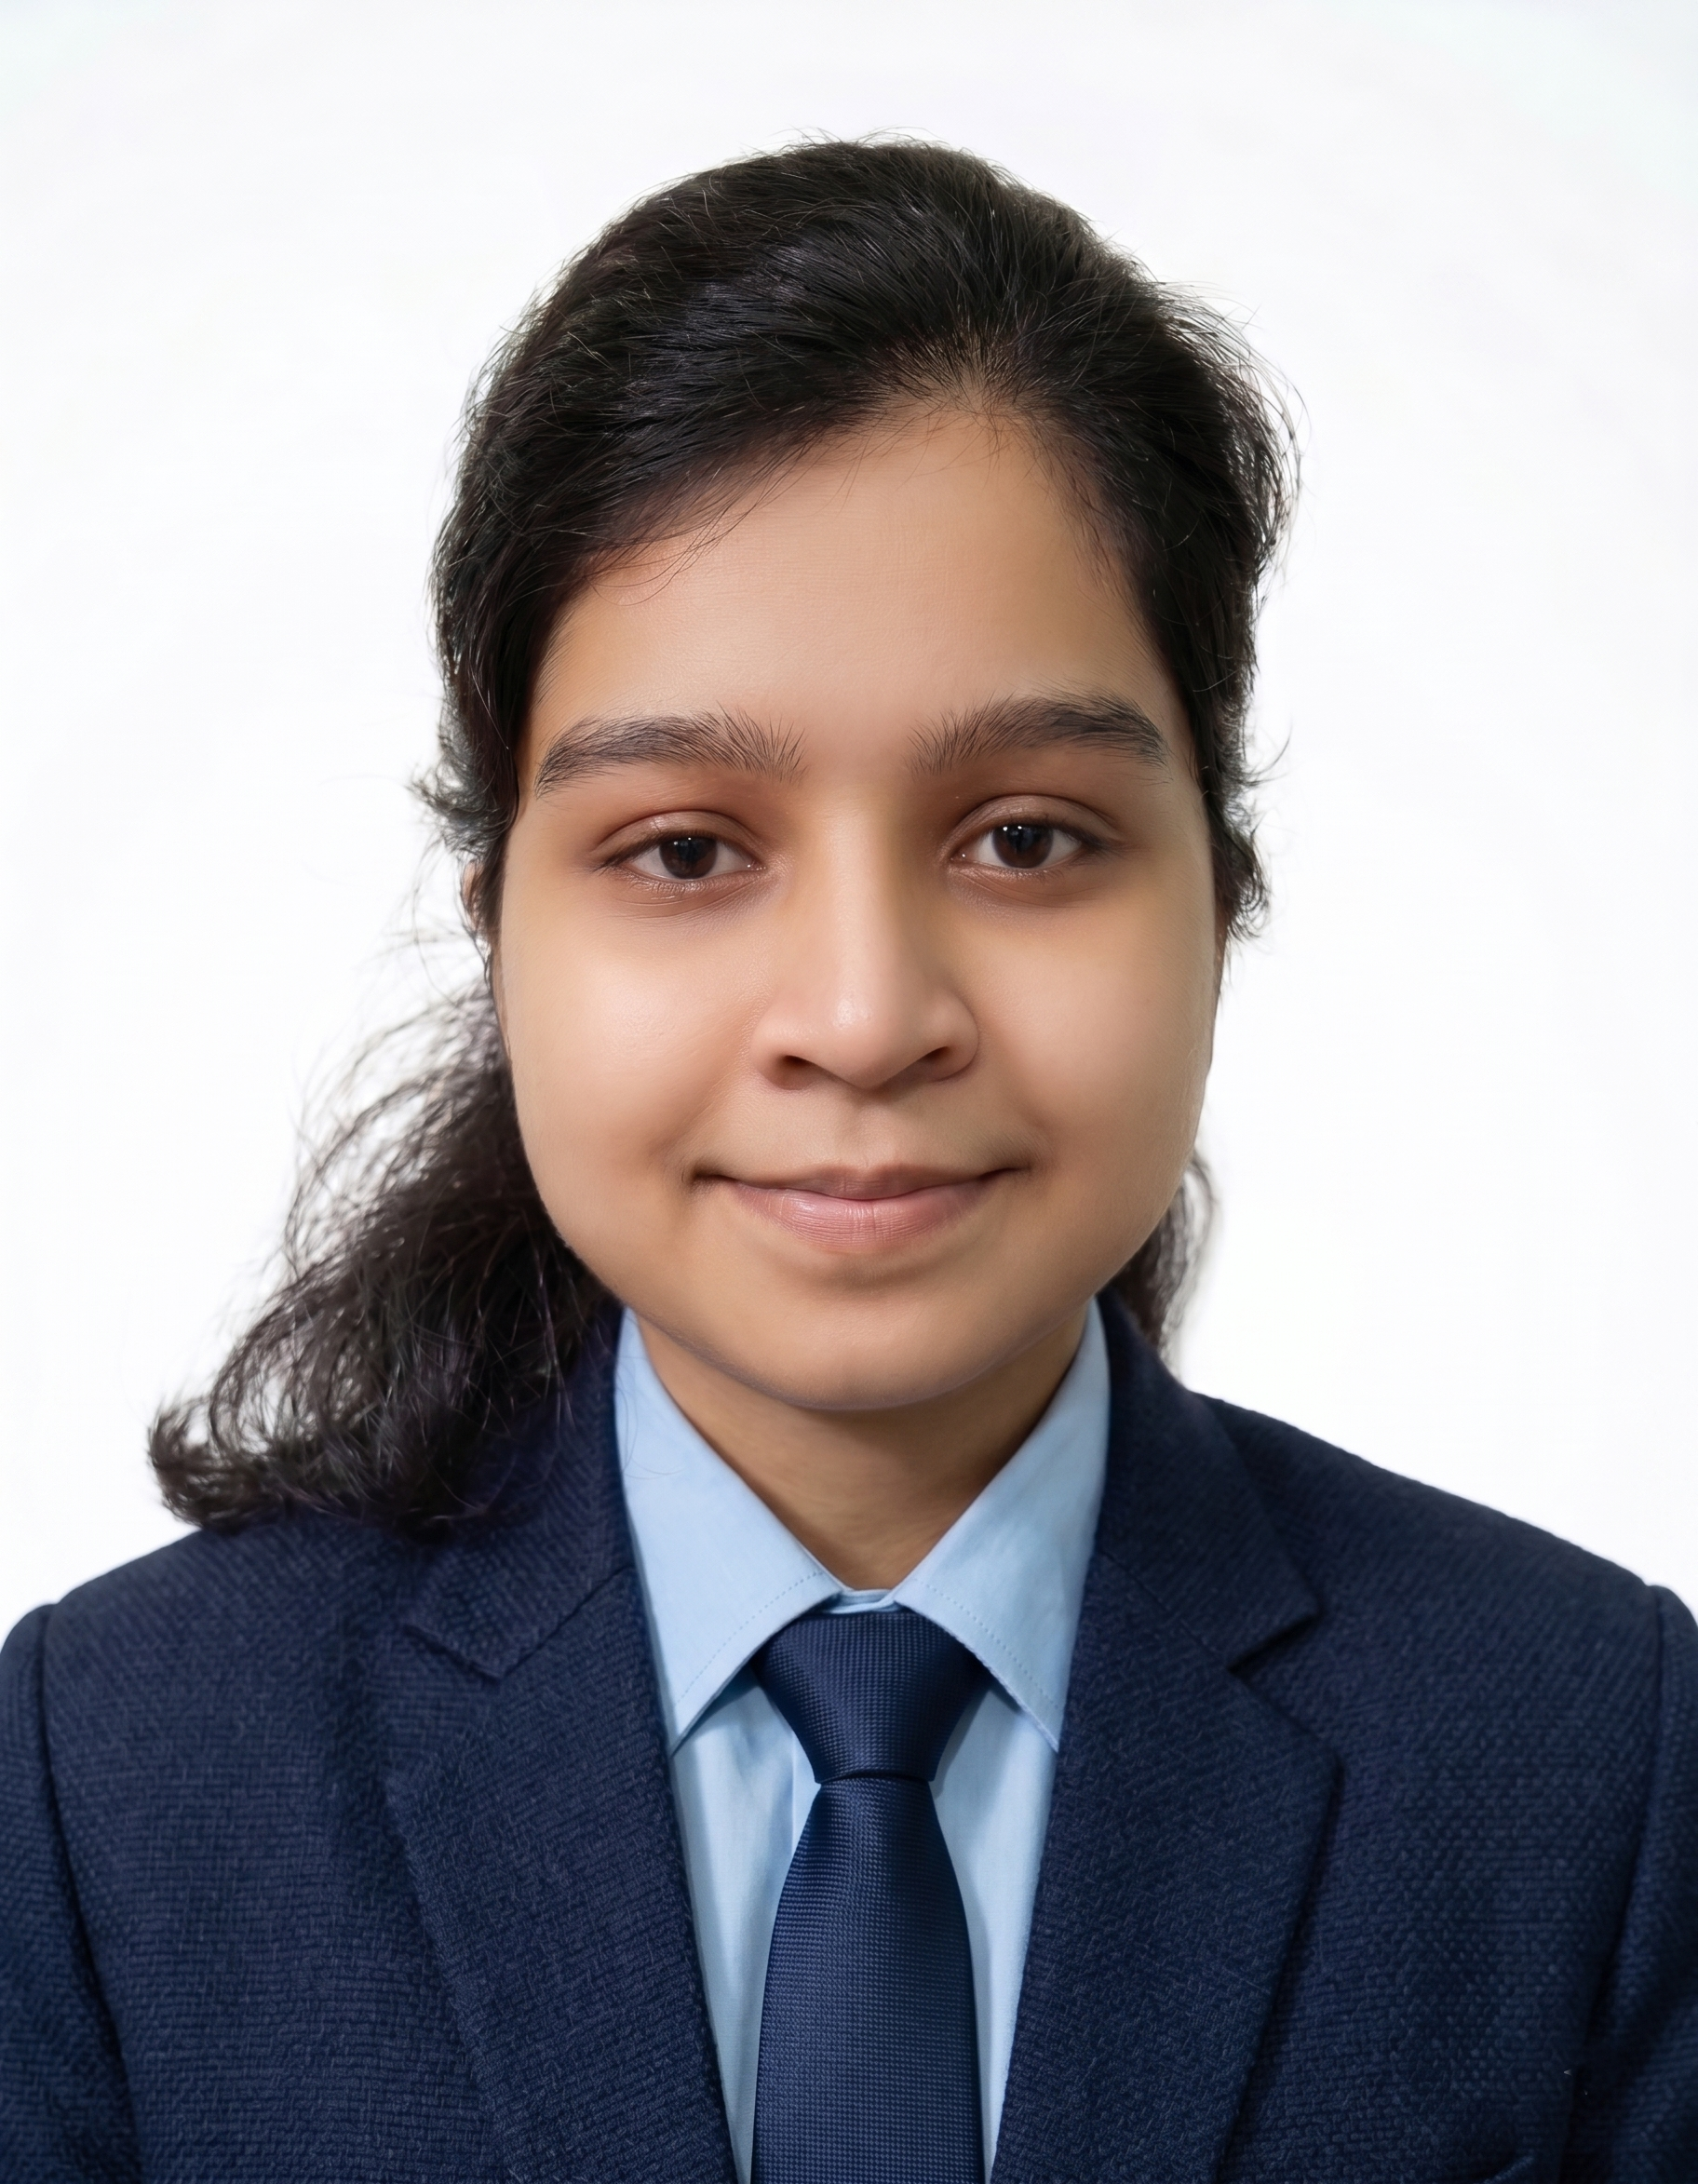
Project Tile – Research Agent
Domain of Project – Education
Student Name | Recent Passport Photo | Email ID | Mobile number [WhatsApp]
Debalina Pal |  | debalinapal2003@gmail.com | 8116919633

Slide 3
Problem Statement -
Problem Statement : Research Agent
The Challenge
Academic and scientific research involves extensive literature reviews, reading research papers, extracting relevant information, identifying research gaps, and managing references. Researchers often spend significant time searching across multiple platforms, analyzing lengthy publications, and organizing research findings.
The scattered nature of research information, difficulty in identifying relevant studies, and time-consuming citation management make the research process inefficient. Additionally, manually comparing existing studies and identifying potential research directions can be challenging.
The Objective
Build an AI-powered Research Agent that automates and simplifies academic and scientific research activities. The solution should provide:
Intelligent Literature Search: Retrieve relevant research papers and academic publications based on natural language queries.
Research Paper Summarization: Generate concise summaries highlighting objectives, methodologies, findings, and conclusions.
Information Extraction: Extract important details, including research methodologies, datasets, results, and limitations.
Reference Management: Organize research papers and generate structured references and citations.
Research Gap Identification: Analyze existing literature to identify limitations and potential research opportunities.
Hypothesis Generation: Suggest potential research hypotheses and future research directions based on retrieved literature.
Report Generation: Generate structured research reports and draft sections of academic papers.

Slide 4
Proposed Solution -
Proposed Solution: AI-Powered Research Agent
The proposed solution is an Agentic AI-powered Research Assistant built using LangFlow, IBM watsonx.ai, and IBM Granite models to automate academic and scientific research activities.
At its core, the system uses a Retrieval-Augmented Generation (RAG) pipeline to retrieve relevant research papers and academic information from reliable sources. The retrieved documents are processed, converted into embeddings, and stored in a vector database, enabling semantic search and context-aware information retrieval.
The solution consists of five specialized agents:
Literature Search Agent: Searches and retrieves relevant academic papers based on user research queries.
Research Summarization Agent: Analyzes research papers and generates concise summaries of objectives, methodologies, results, and conclusions.
Information Extraction Agent: Extracts important research details, including datasets, experimental methods, findings, and limitations.
Research Analysis Agent: Compares multiple research papers, identifies research gaps, and suggests potential hypotheses and future directions.
Report Generation Agent: Organizes retrieved information into structured research reports and assists in drafting academic content with references.
The system provides an interactive user interface where researchers can submit queries, upload research papers, receive summarized information, and generate structured research outputs.
LangFlow orchestrates the multi-agent workflows, while IBM watsonx.ai provides access to IBM Granite models for natural language understanding, reasoning, and content generation.
Overall, ResearchMate aims to transform traditional research workflows into an intelligent, automated, and efficient research assistance system.

Slide 5
Technology Used
Technology | Purpose
LangFlow | Visual design and orchestration of multi-agent workflows.
IBM Granite Model | Natural language understanding, reasoning, summarization, and research content generation.
IBM Cloud Lite Services | Cloud infrastructure and access to IBM services for building the Research Agent.
IBM watsonx.ai | Access to Granite foundation models and embedding capabilities.
RAG (Retrieval-Augmented Generation) | Retrieves relevant research information before generating context-aware responses.
Vector Database (FAISS/Chroma) | Stores document embeddings and enables semantic retrieval of research papers.
Python | Document processing, data extraction, and backend integration.

Slide 6
Langflow component Used -
1. Chat Input – Provides an interface where users enter research questions or queries.
2. File Component – Allows users to upload research papers and PDF documents for analysis.
3. IBM watsonx.ai Agent – Processes research queries using IBM Granite models and performs intelligent reasoning.
4. IBM Granite Model – Granite-4.0-8B-Instruct (or the actual Granite model selected in your implementation) for research summarization, analysis, and response generation.
5. Document Parser / PDF Loader – Extracts textual content from uploaded research papers.
6. Text Splitter – Divides large research documents into smaller chunks for efficient retrieval.
7. Embeddings Component – Converts research document chunks into vector representations.
8. Vector Store – Stores document embeddings and retrieves relevant information using semantic similarity.
9. Retriever – Fetches relevant research content based on user queries.
10. Prompt Template – Structures instructions for research analysis, summarization, and report generation.
11. Chat Output – Displays AI-generated summaries, research insights, and reports.

Slide 7
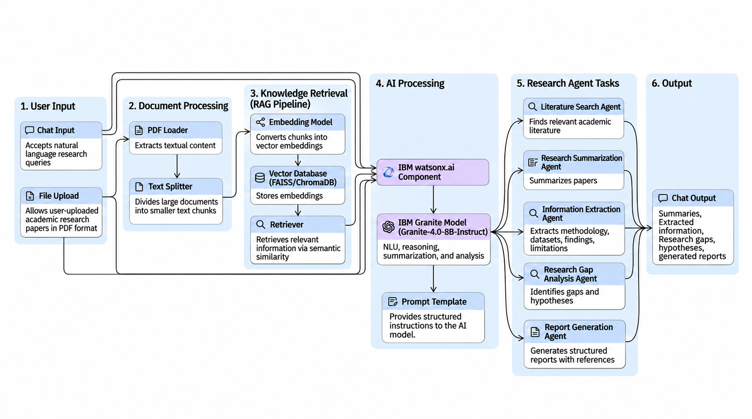
Langflow workflow -

Slide 8
Architecture blueprint
Layer | Components
User Layer | Researcher, student, research query, PDF upload
Application Layer | ResearchMate interface / frontend
Processing Layer | PDF parser, text splitter, document processor
Retrieval Layer | Embeddings, vector database, semantic retriever
AI Layer | IBM Granite Model through IBM watsonx.ai
Agent Layer | Literature Search, Summarization, Information Extraction, Research Analysis, Report Generation
Output Layer | Research summaries, insights, references, hypotheses, reports
Architecture flow:
User → ResearchMate Interface → Document Processing → Embeddings & Vector Database → RAG Retrieval → IBM Granite Model → Specialized Research Agents → Generated Research Output.

Slide 9
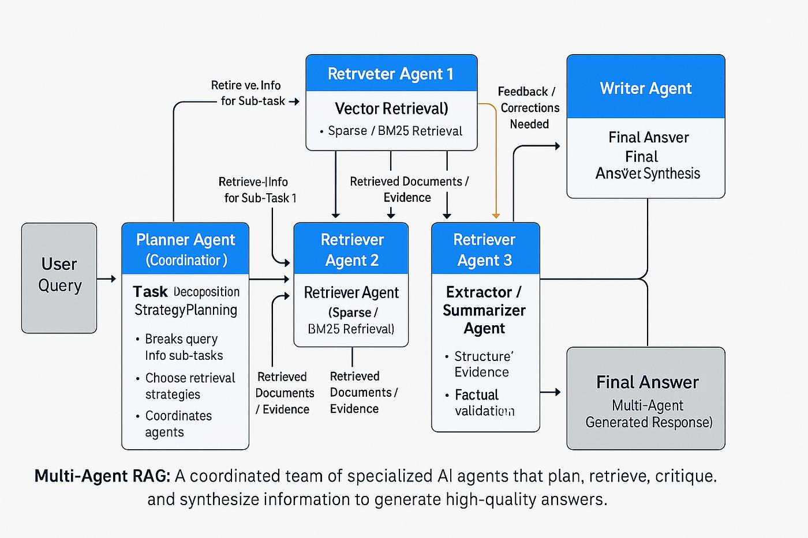
Architecture blueprint

Slide 10

Role of Agentic AI in the solution
Agentic AI enables ResearchMate to function as an intelligent research assistant rather than a conventional chatbot. Using IBM watsonx.ai and IBM Granite models, the system coordinates multiple specialized agents to automate different stages of the research process.
Each agent performs a specific task, such as retrieving academic literature, summarizing research papers, extracting important information, identifying research gaps, and generating structured research reports.
The system uses context awareness to understand research questions and retrieve relevant information from available documents. Through multi-agent collaboration, different agents work together to process research queries and produce meaningful research insights.
The integration of Retrieval-Augmented Generation (RAG) helps ground generated responses in retrieved research documents, improving relevance and reducing unsupported information.
Overall, Agentic AI makes ResearchMate an intelligent, goal-oriented research assistant that simplifies literature analysis, improves research efficiency, and supports informed academic decision-making.

Slide 11
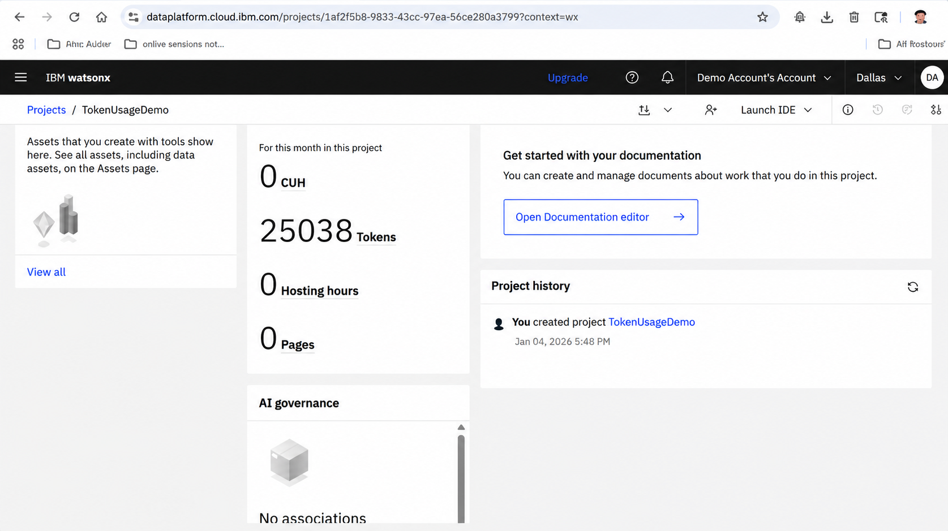
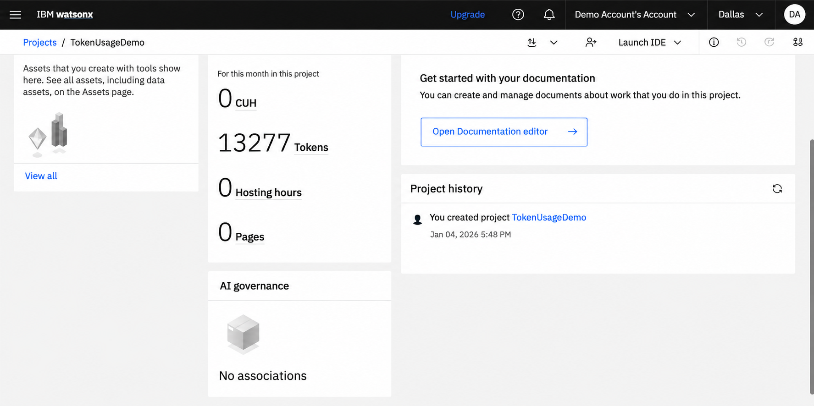
Token Usage
11,761 token are used
Before Prompt
After the Prompt
·
·
·

Slide 12
Novelty and Uniqueness
Novelty and Uniqueness of ResearchMate
The proposed ResearchMate stands out by combining Agentic AI, Retrieval-Augmented Generation, and automated research analysis into a unified intelligent system.
Multi-Agent Intelligence: Specialized agents collaborate to automate different stages of academic research.
RAG-Based Research Retrieval: Retrieves relevant information from research documents before generating responses.
Intelligent Paper Summarization: Converts lengthy academic publications into concise and understandable summaries.
Automated Information Extraction: Identifies important research methodologies, datasets, findings, and limitations.
Research Gap Identification: Compares existing literature to highlight unexplored areas and potential research opportunities.
Hypothesis Generation: Suggests possible research hypotheses and future research directions.
Automated Report Generation: Organizes research findings into structured reports with references.
IBM Granite Integration: Uses IBM foundation models through watsonx.ai for intelligent reasoning and research assistance.
This makes ResearchMate an intelligent research companion that goes beyond basic document summarization by assisting researchers throughout the research lifecycle.

Slide 13
Git Hub Link
Github URL – https://github.com/dEBaLINA1048/research-agent
·
·
·

Slide 14
Future Scope
1. Integration with More Academic Research Databases
Integrating research sources such as Google Scholar, Semantic Scholar, arXiv, and other academic repositories can improve literature discovery and provide access to a broader collection of scientific publications.
2. Advanced Citation and Reference Management
Future versions can support automatic citation generation in different academic formats, including IEEE, APA, MLA, and Springer.
3. Multilingual Research Support
Adding multilingual capabilities will allow researchers to interact with the system in different languages and analyze research publications from diverse linguistic backgrounds.
4. Research Collaboration and Knowledge Sharing
The system can be extended with collaborative workspaces where multiple researchers can share papers, summaries, research findings, and generated reports.
5. Advanced Research Analytics
Future enhancements can include research trend analysis, citation network visualization, paper comparison dashboards, and identification of emerging research topics.
·
·
·

Slide 15
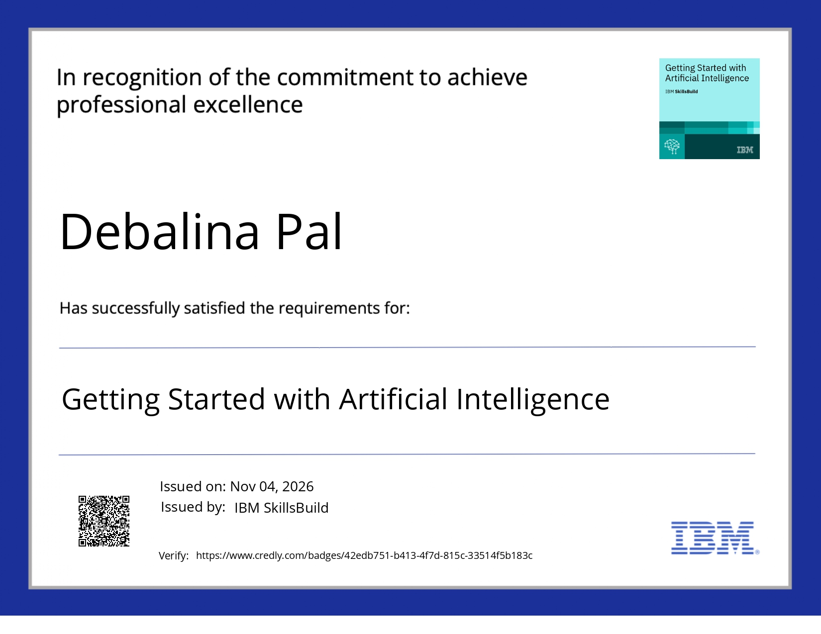
Certificates Earned:
credly certificate

Slide 16
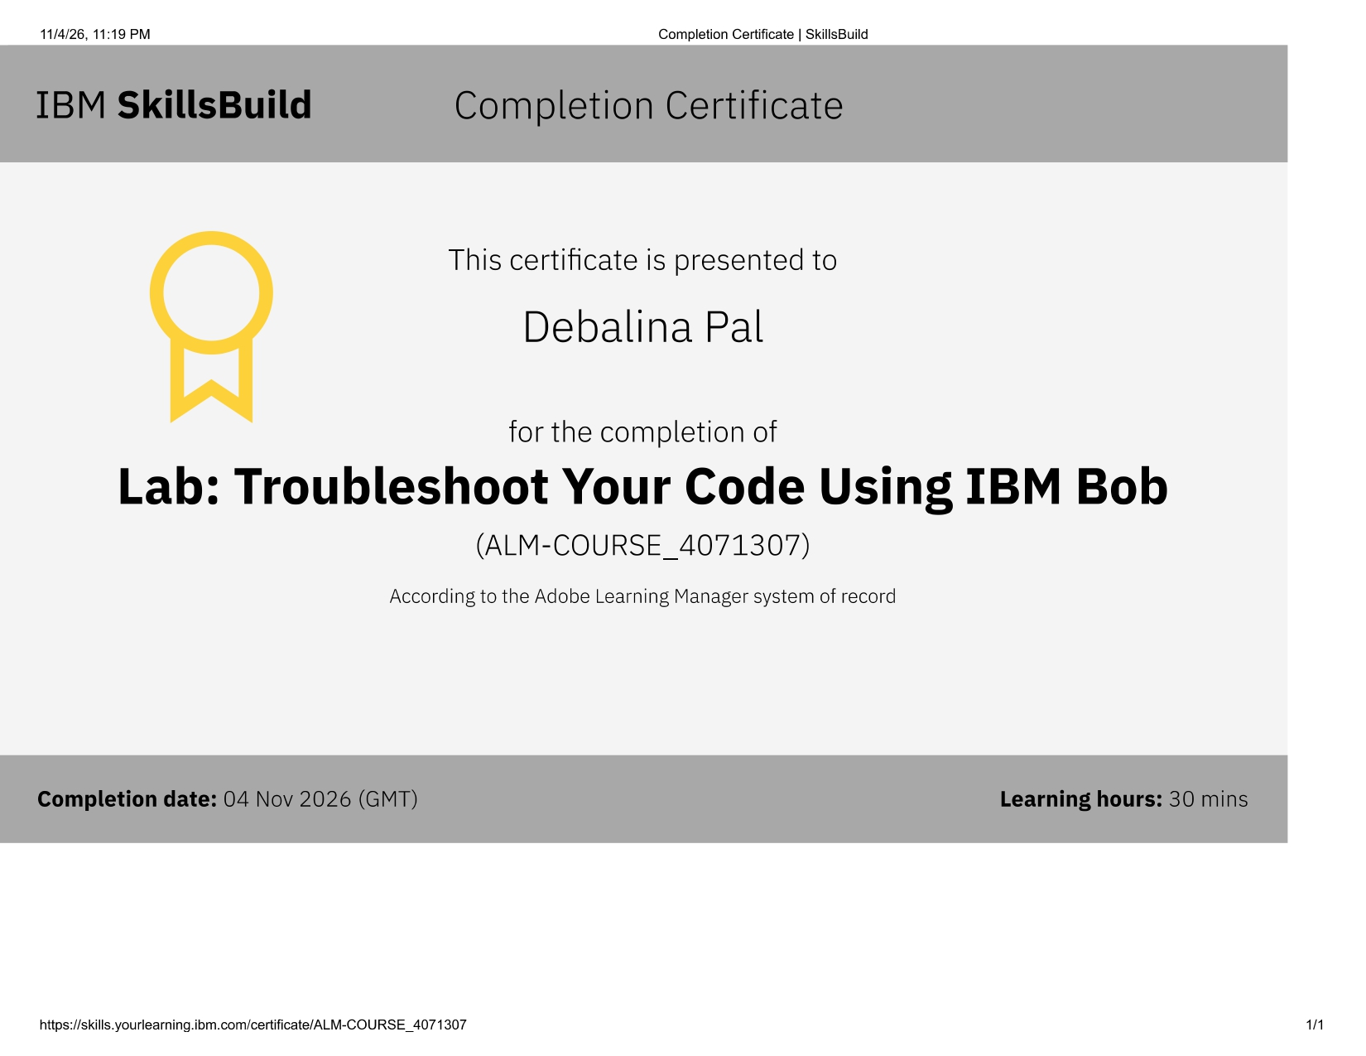
Certificates Earned:​
IBM BOB Certificate

Slide 17


